Slide 1

Machine Learning Based Analysis of Crypto Currency Market Financial Risk Management
by
S Eswari
Roll No. 204G1A0530
B Amrutha
Roll No. 204G1A0509
J Aishwarya
Roll No. 204G1A0505
S Diya Farnaaz
Roll No. 204G10A529
V Manohar
Roll No. 204G1A0553
Under the guidance of
G Lokeswari M.Tech(Ph.D)
Assistant Professor
Department of Computer Science and Engineering
Srinivasa Ramanujan Institute of Technology
(Autonomous)
2023 - 2024

Slide 2
Comments
Explore Data Sets and learn Algorithms in more detail.
Place Block Diagram and show Example of Risk.
Comparison of Algorithms.
Paper rewrite and place equations.

Slide 3

Contents
Abstract
Introduction
Literature Survey
Existing System
Proposed System
Planning
Design
Implementation
Research Paper
References

Slide 4
Abstract
Crypto currency is a well-known financial state in the globe, posing a variety of dangers that have an impact on the intrinsic risk assessment of risk auditors. Since its inception, the rise of crypto currencies has presented financial institutions with a wide range of risks in terms of money laundering. In the institution of financial supports such as anti-money laundering, banks, and bank secrecy, continue as a risk specialist, bank manager, and compliance officer who has a provocation for the connected transaction through crypto currencies and the users who conceal the funds. So for analysing the financial risk machine learning techniques are used they are , Decision Tree , MLP Classifier, Adaboost, Extra Tree Classifier, Random Forest.
Key Words: Risk, MLP Classifier, Decision Tree, Adaboost, Extra Tree Classifier, Random Forest.

Slide 5
Introduction
Machine learning-based analysis of cryptocurrency market financial risk management is to address the challenge of accurately assessing and predicting the volatile nature of cryptocurrency markets, including price fluctuations, market manipulation, and regulatory uncertainties.
The cryptocurrency market, with its 2500 types and $252.5 trillion trading volume, operates in a complex and volatile environment.
Develop robust models that can provide timely and reliable risk assessments, aiding investors and financial institutions in making informed decisions and managing their exposure to financial risks in the cryptocurrency market.
Proposed system consist of filtering the dataset which is collected from Kaggle website and finding accuracy of different algorithms and finally to predict the risk.

Slide 6
Literature survey for first objective
According to Zeinab Shahbazi [1],
The risk management of cryptocurrency network analyzed using the Reinforcement Learning (RL) technique .
Hierarchical Risk Parity (HRP) asset allocation method in a cryptocurrency portfolio.
Tianyu Ray Li [2] applied ,
Cryptocurrency Financial Risk Analysis using Machine Learning
For pricing cryptocurrency collective finances they used sentiment analysis.

Slide 7
Literature survey for first objective
According to Dr. B. Subba Reddy [3],
The risk management of cryptocurrency using machine learning.
Find the risk using SVM, Logistic Regression, Decision Tree Classifier.
According to C. Y. Kim and K. Lee [4],
Risk management to cryptocurrency exchange and investors guidelines to prevent potential threats, vulnerabilities in cryptocurrency exchanges and individual user wallets, proposing risk management methods based on international standards like NIST and ISO to address these weaknesses.
According to J. Gold and S. D. Palley [5],
Companies impacted by the exploit should immediately contact law enforcement and take technical risk mitigation steps, such as generating new keys for cryptocurrency wallets, implementing hardware wallets, and introducing two-factor authentication.

Slide 8
Existing System
In the existing system, implementation of machine learning algorithms is bit complex to build due to the lack of information about the data visualization. The RL was compared to existing research works and the most frequent benchmarks in this area, the two management portfolio algorithms and the basic DQN of the trading system.
In terms of bit-coin risk management, the proposed RL algorithms are compared to other existing studies. To overcome all this, we use machine learning packages available in the scikit-learn library.
Disadvantages:
High complexity.
Time consuming.

Slide 9
Proposed System
AIM :
Proposed system provides a rich tapestry of approaches and techniques employed in the realm of cryptocurrency financial risk management. By assimilating and synthesizing these findings, practitioners can refine their methodologies, optimize model performance, and develop robust frameworks for risk assessment in cryptocurrency markets. Through this collaborative and iterative process, the field can advance significantly, providing more effective tools and strategies for navigating the complexities and uncertainties inherent in cryptocurrency financial risk management.
Advantages:
Highest accuracy
Reduces time complexity.
Easy to use

Slide 10
Proposed System
The objectives of this proposed system:
1.Diverse Models :Use a mix of models like Decision Trees, Random Forests, MLP classifiers, Ada Boost, and Extra Tree Classifier.
2.Careful Selection :Choose models that suit the complexities of cryptocurrency markets and challenges of risk assessment.
3.Leverage Strengths :Each model has unique strengths: Decision Trees offer transparency, Random Forests use ensemble techniques, MLP classifiers excel in pattern recognition, AdaBoost iteratively improves, and Extra Tree Classifier enhances generalization.
4.Transparency :Decision Trees provide clear decision paths for easy interpretation of risk factors.

Slide 11
Proposed System
5.Ensemble Methods :Random Forests and AdaBoost combine predictions for improved accuracy and robustness.
6.Pattern Recognition :MLP classifiers capture intricate patterns in market data for better risk assessment.
7.Iterative Improvement: AdaBoost adjusts weights of misclassified instances over iterations, refining predictions.
8.Randomness for Generalization: Extra Tree Classifier introduces randomness to reduce variance and improve generalization, crucial for navigating cryptocurrency market complexities.

Slide 12
Planning
Objectives :
The Objectives of this project are
Collect the data , preprocess the collected data set and finally train the data set.
Find the Accuracy of Algorithms used in the project.
To predict the Risk found or not while investing in crypto markets.
Performance
Filter the data set and find the Accuracy of different algorithms used in the implementation of the project.
Predicting whether risk found or not based on the inputs collected from the user.

Slide 13
Planning
Functional Requirements
Authentication of user whenever he/she logs into the system.
User can reset their password through Forget Password Option.
User can see the filtered Data set.
User can see the comparison of different algorithm’s Accuracy by Graphs.
Non-Functional Requirements
Flexibility
Security
Performance
Reliability
Usability
Portability

Slide 14
Planning
System Requirements:
H/W Configuration:
Operating system : Windows 7 or 7+
RAM : 8 GB
Hard disc or SSD : More than 500 GB
Processor : Intel 3rd generation or high or Ryzen with 8 GB RAM
Software Requirements:
Software’s : Python 3.6 or high version
IDE : PyCharm.
Framework : Flask, pandas, numPy and Scikit-Learn

Slide 15
Planning
Methodology
This project uses Agile methodology. In that we use scrum agile methodology.
Scrum is characterized by cycles or stages of development, known as sprints.
It has four stages: Planning, Implementation, Testing and review.
Advantages:
This Methodology has ability to change and adapt with and satisfy the changing needs in short term.
Requires less documentation.

Slide 16
Planning
User:
View Home page:
Here user view the home page of the Crypto Web application.
View about page:
In the about page, users can learn more about the Crypto platform.
View load page:
In the load data page , the user will load the dataset for modelling.
View Page:
User will see the dataset.
Input Model:
The user must provide input values for the certain fields in order to get results.

Slide 17
Planning
View Results:
User view’s the generated results from the model.
View score:
Here user can view the accuracy score in %.
Find Risk:
Here user can view the prediction that the risk is found or not.
Graph:
Comparison of accuracy for every model.

Slide 18
Planning
Work Schedule
S.No | Development Stage | Duration
1. | Domain and Title | 1 week
2. | Literature Survey | 2 weeks
3. | Planning | 1 week
4. | Design | 1 week
5. | Requirements Gathering | 1 week
6. | Testing | 3 weeks
7. | Implementation | 4 weeks

Slide 19
Design - ER Diagram
The ER diagram was created to help grasp the entire scenario. It was used to conceive the phenomena, actions, and interactions between numerous entities, as well as to arrive at the precise requirements in a complete manner.
View home page
Working on Data
User
Preprocessing
View load page
Relationship
View preprocessor page
Training
System
View Results
Select Model
Model Building
Generate Results

Slide 20
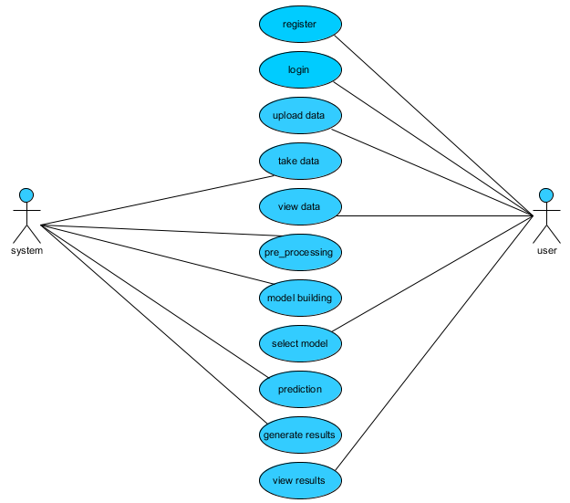
Use case diagram
Design - Use Case Diagram

Slide 21
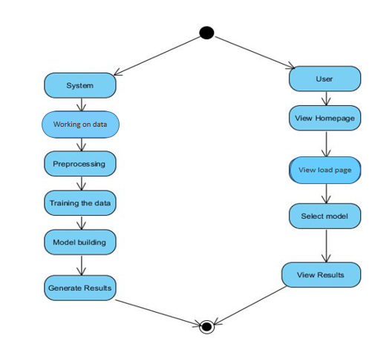
Use case diagram
Design - Activity Diagram

Slide 22
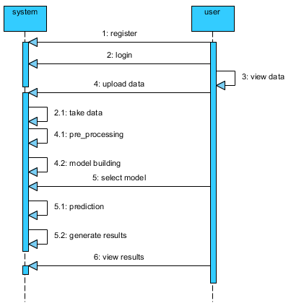
Use case diagram
Design - Sequence Diagram

Slide 23
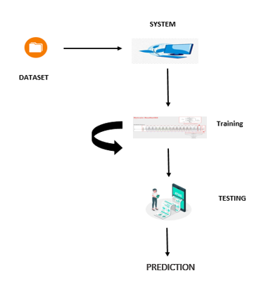
Use case diagram
Design - System Architecture

Slide 24
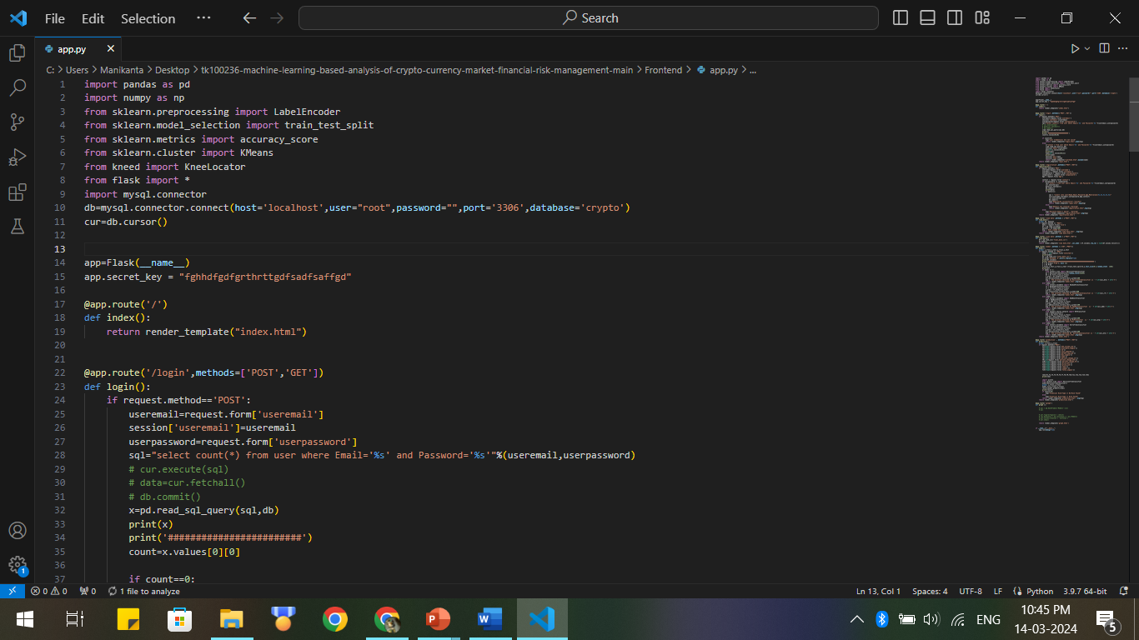
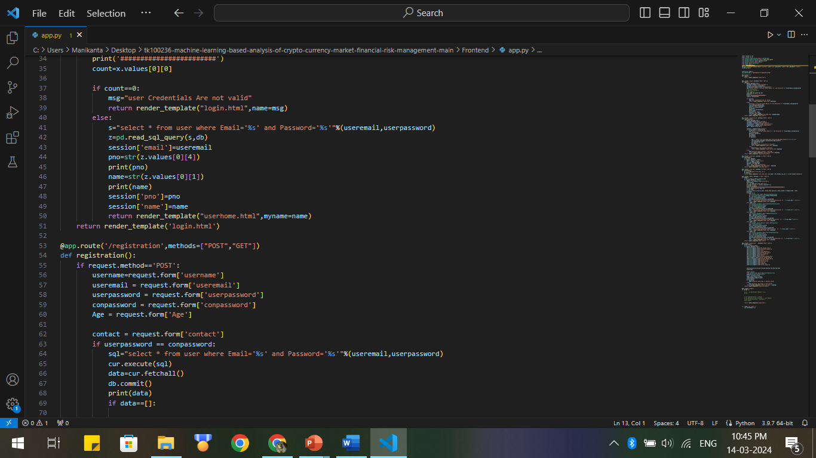
Implementation

Slide 25
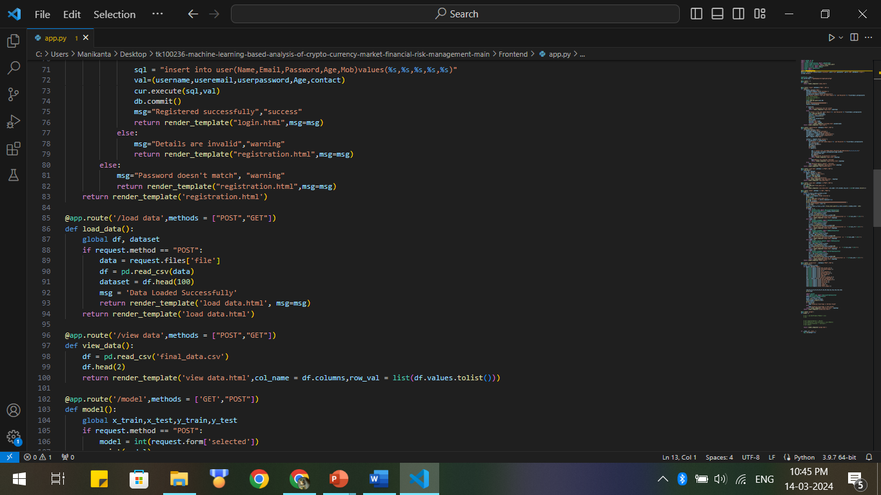
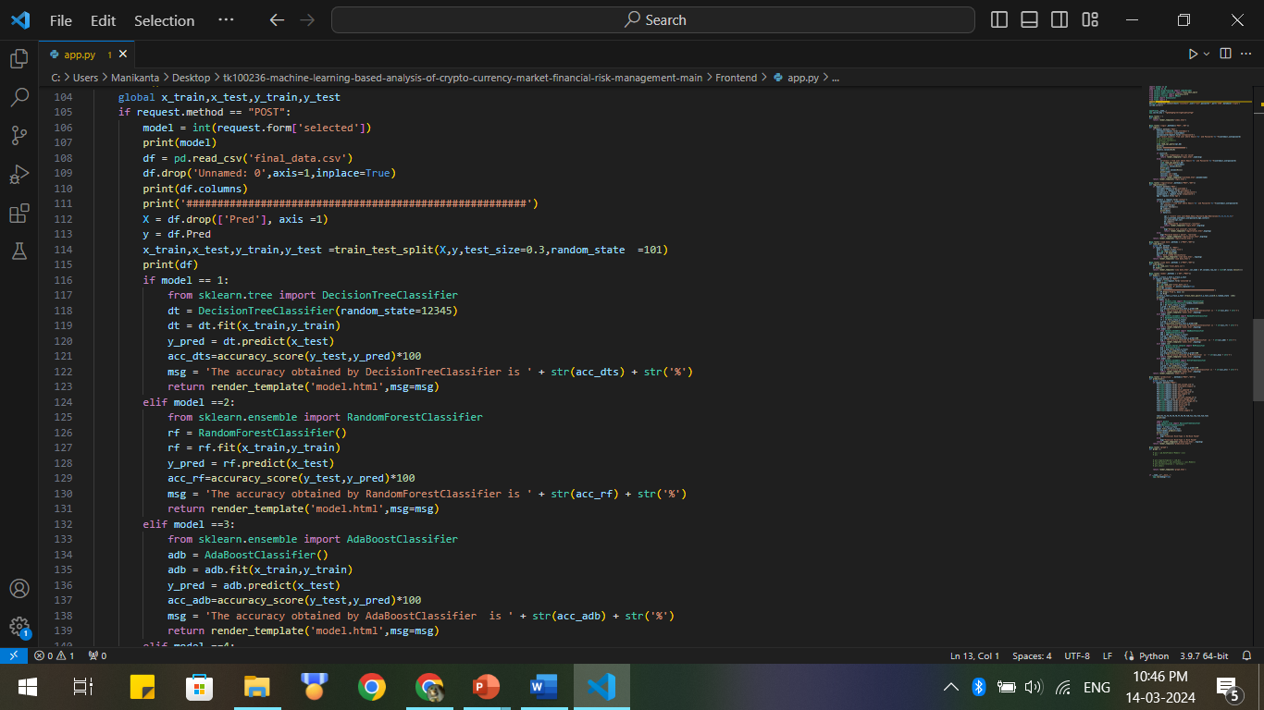
Implementation

Slide 26
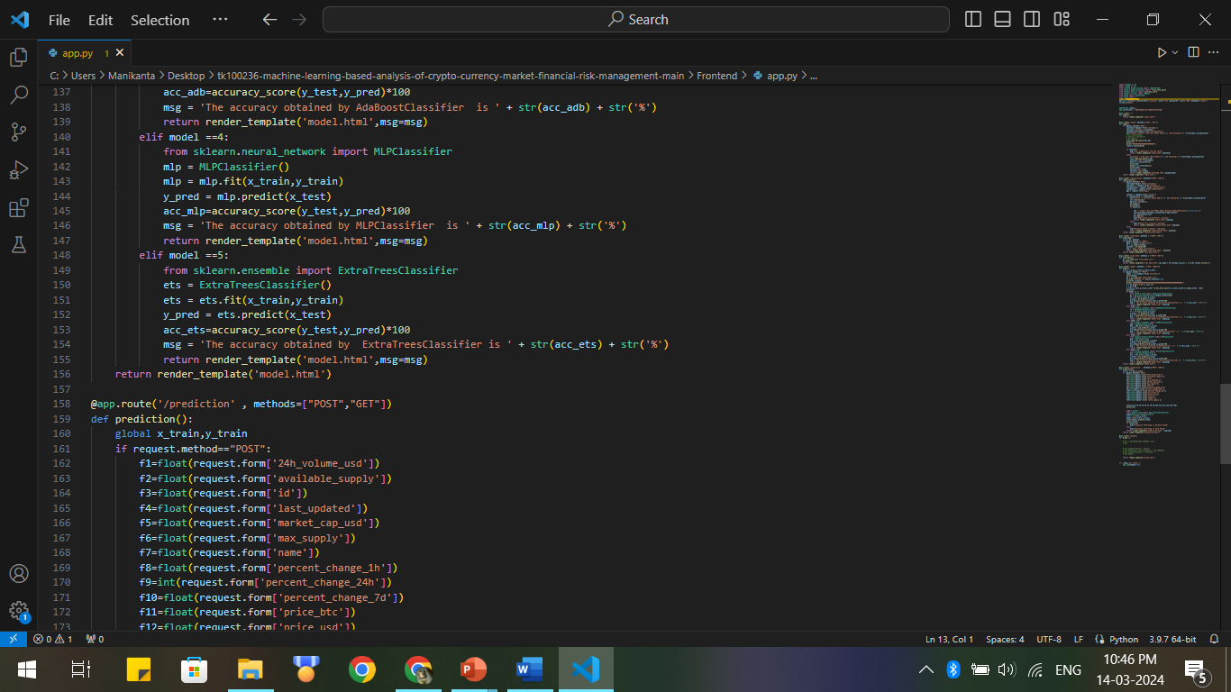
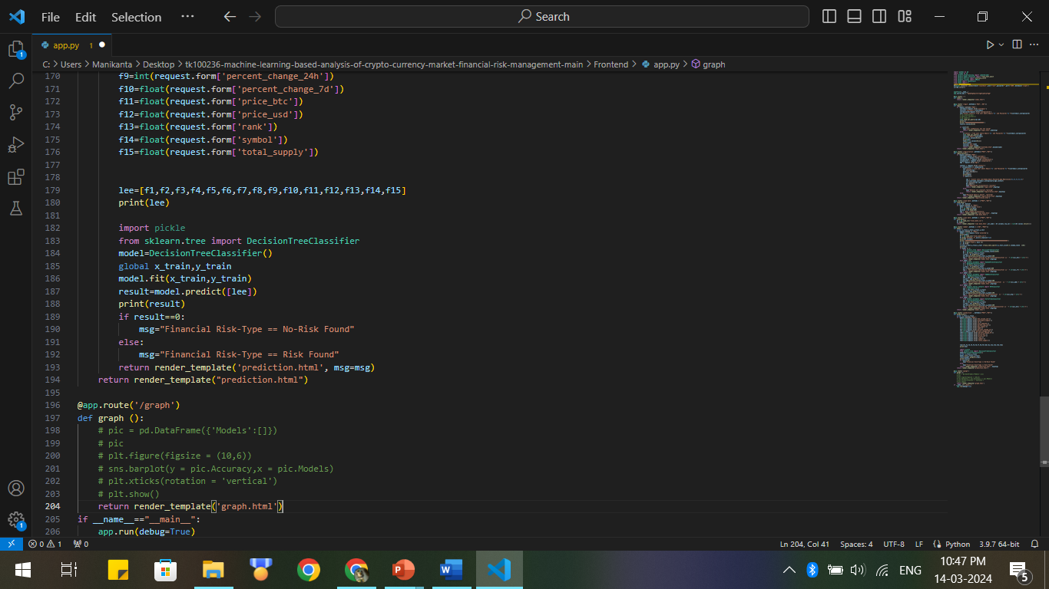
Implementation

Slide 27
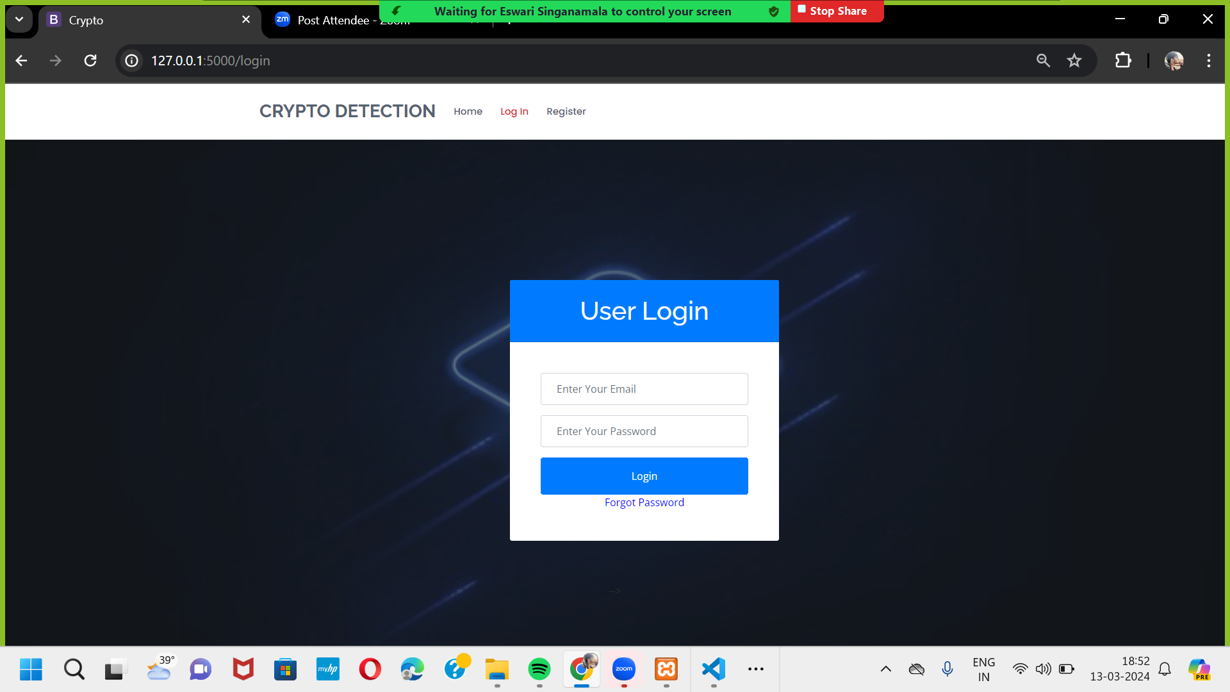
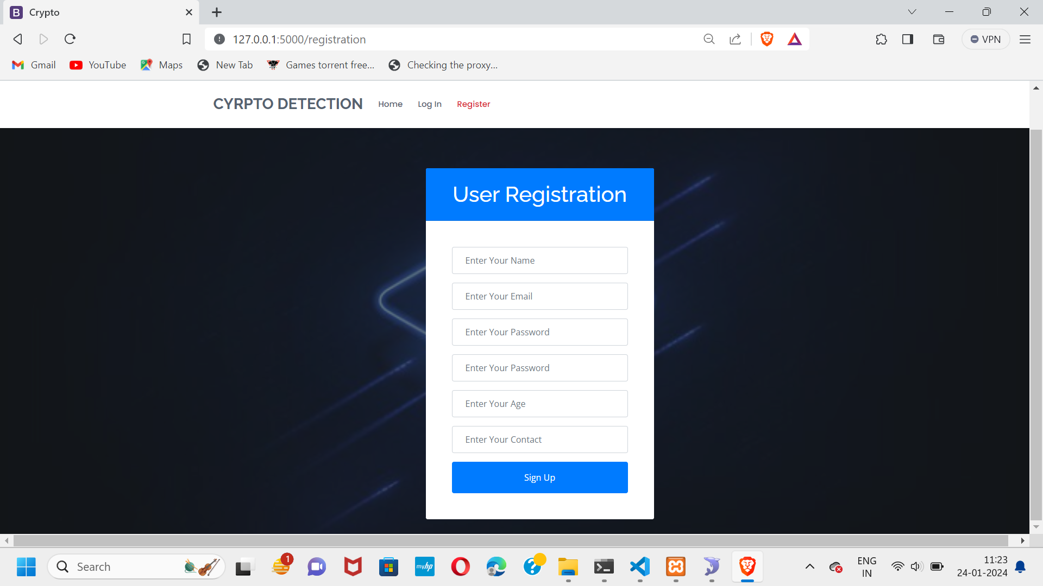
Implementation
Output Screenshots

Slide 28
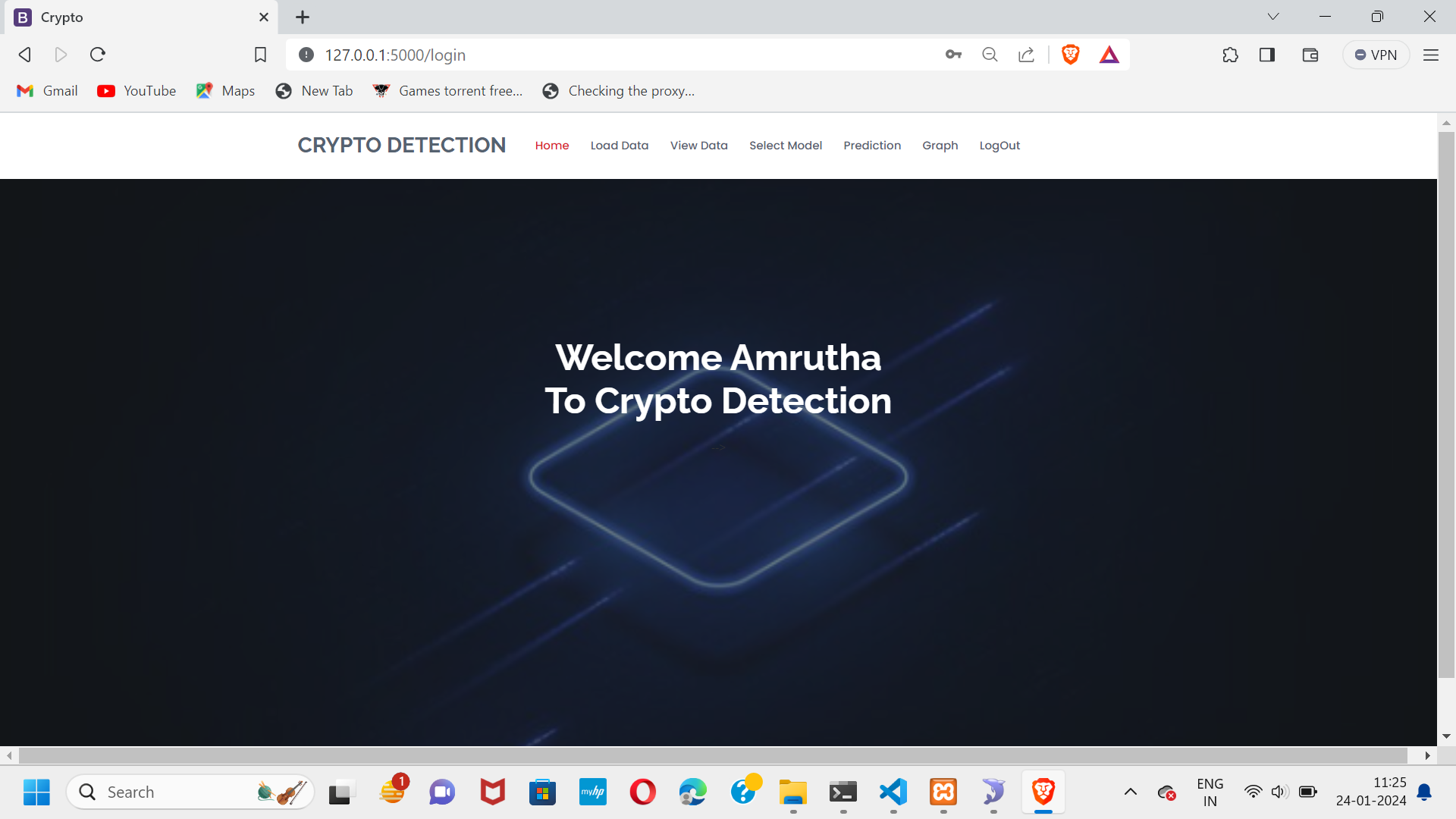
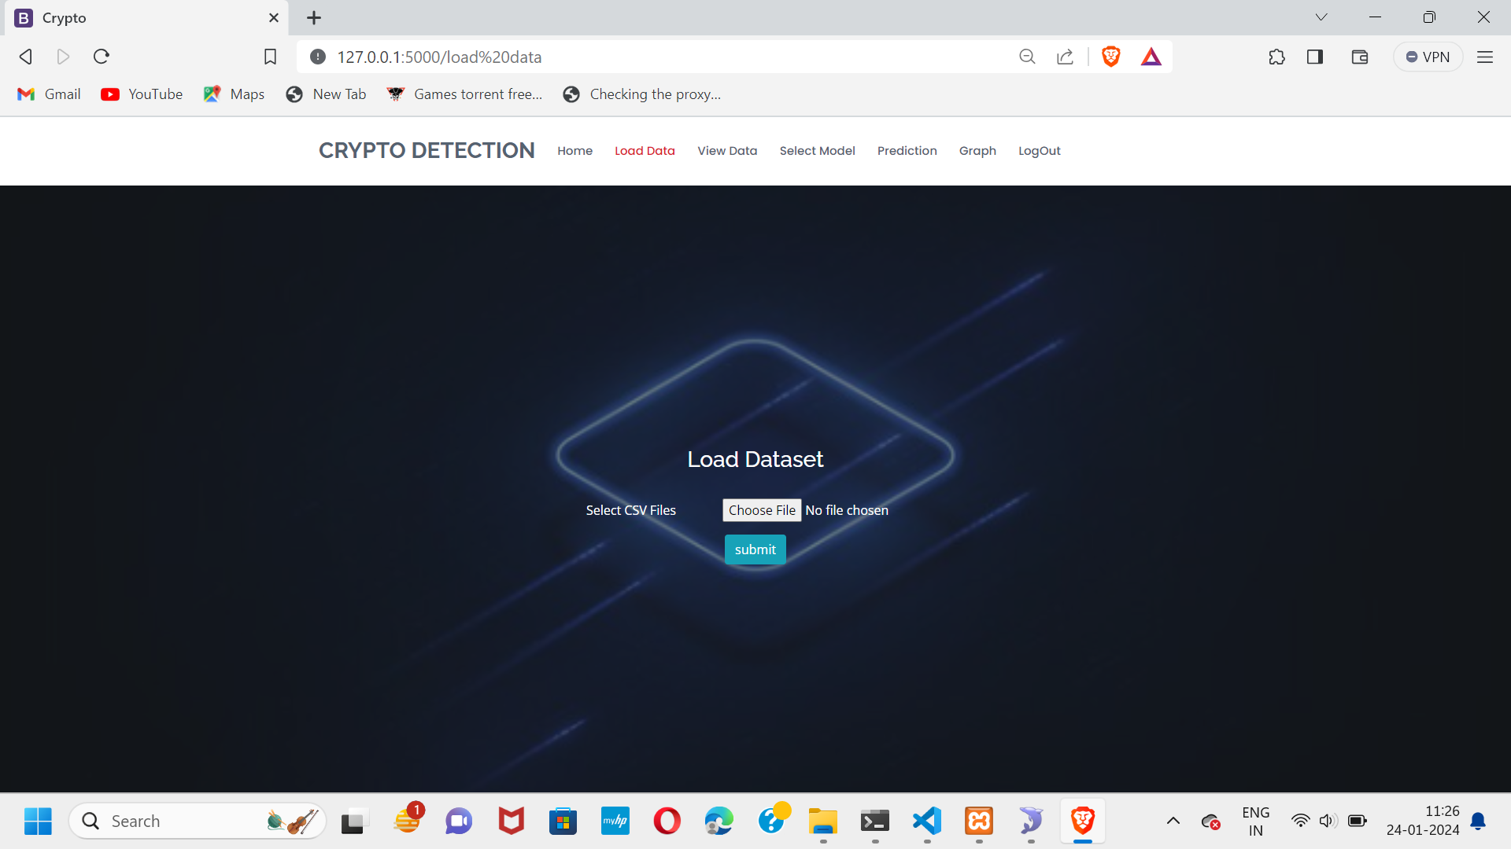
Implementation

Slide 29
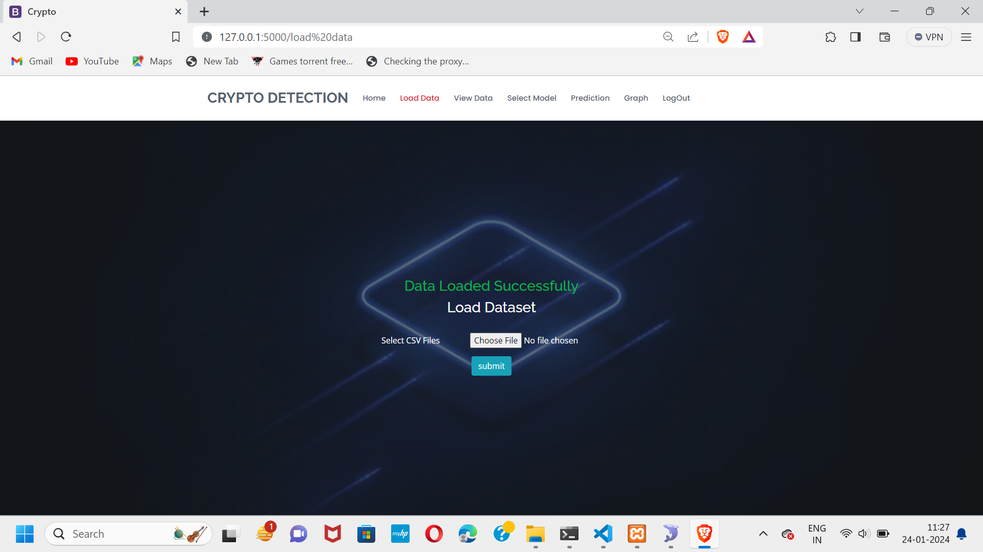
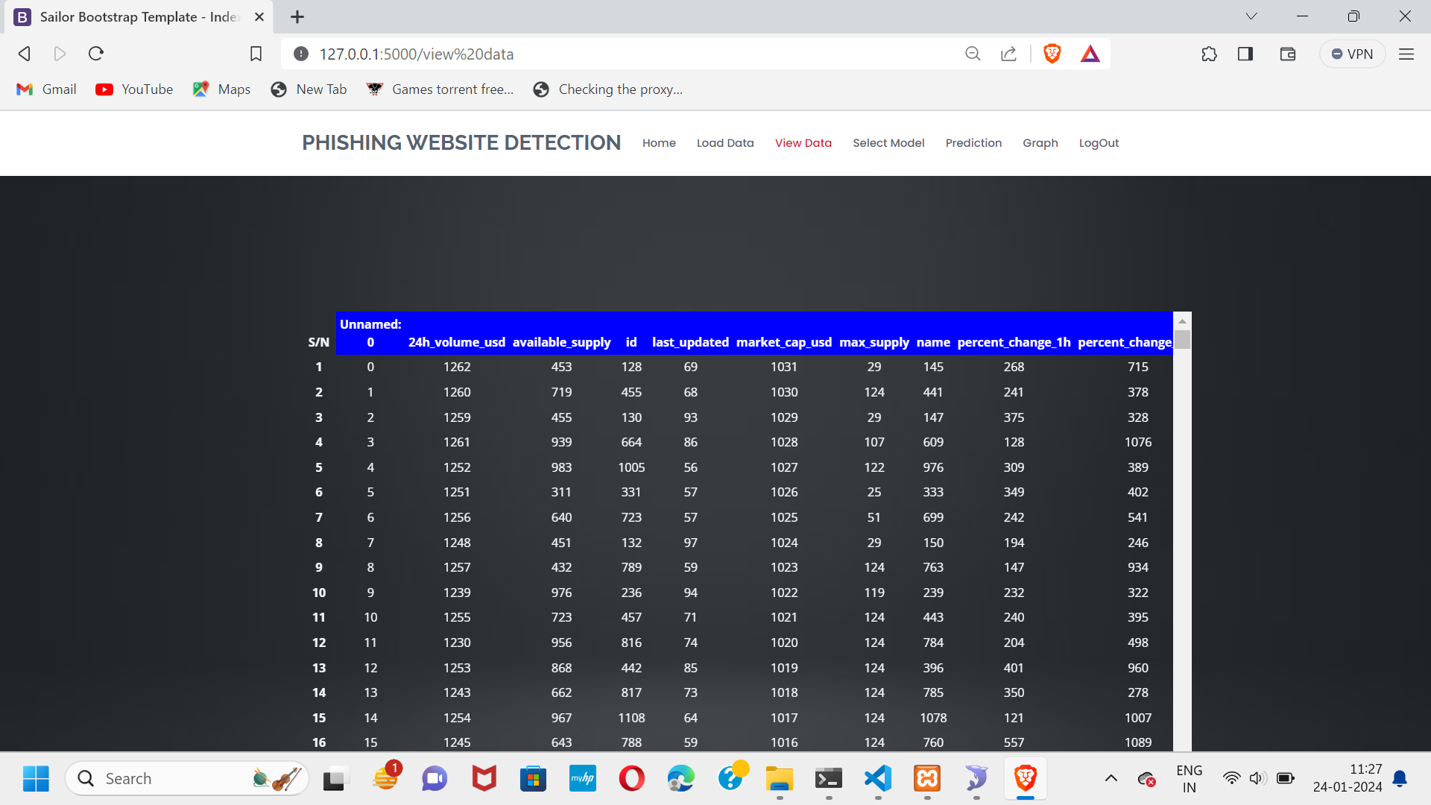
Implementation

Slide 30
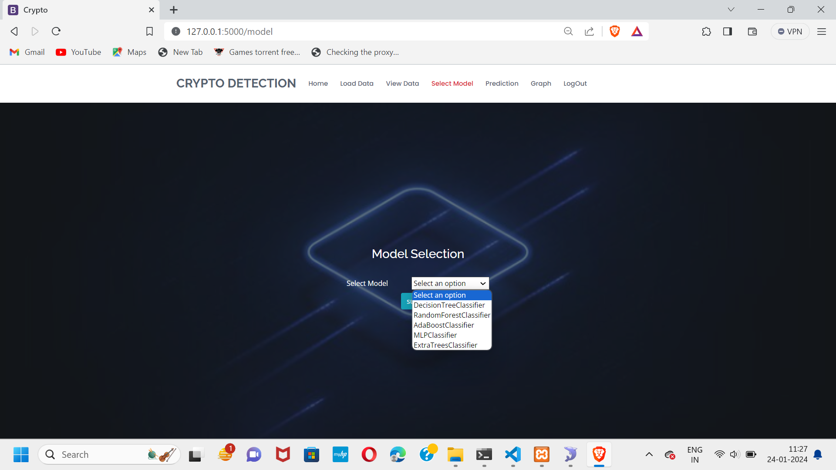
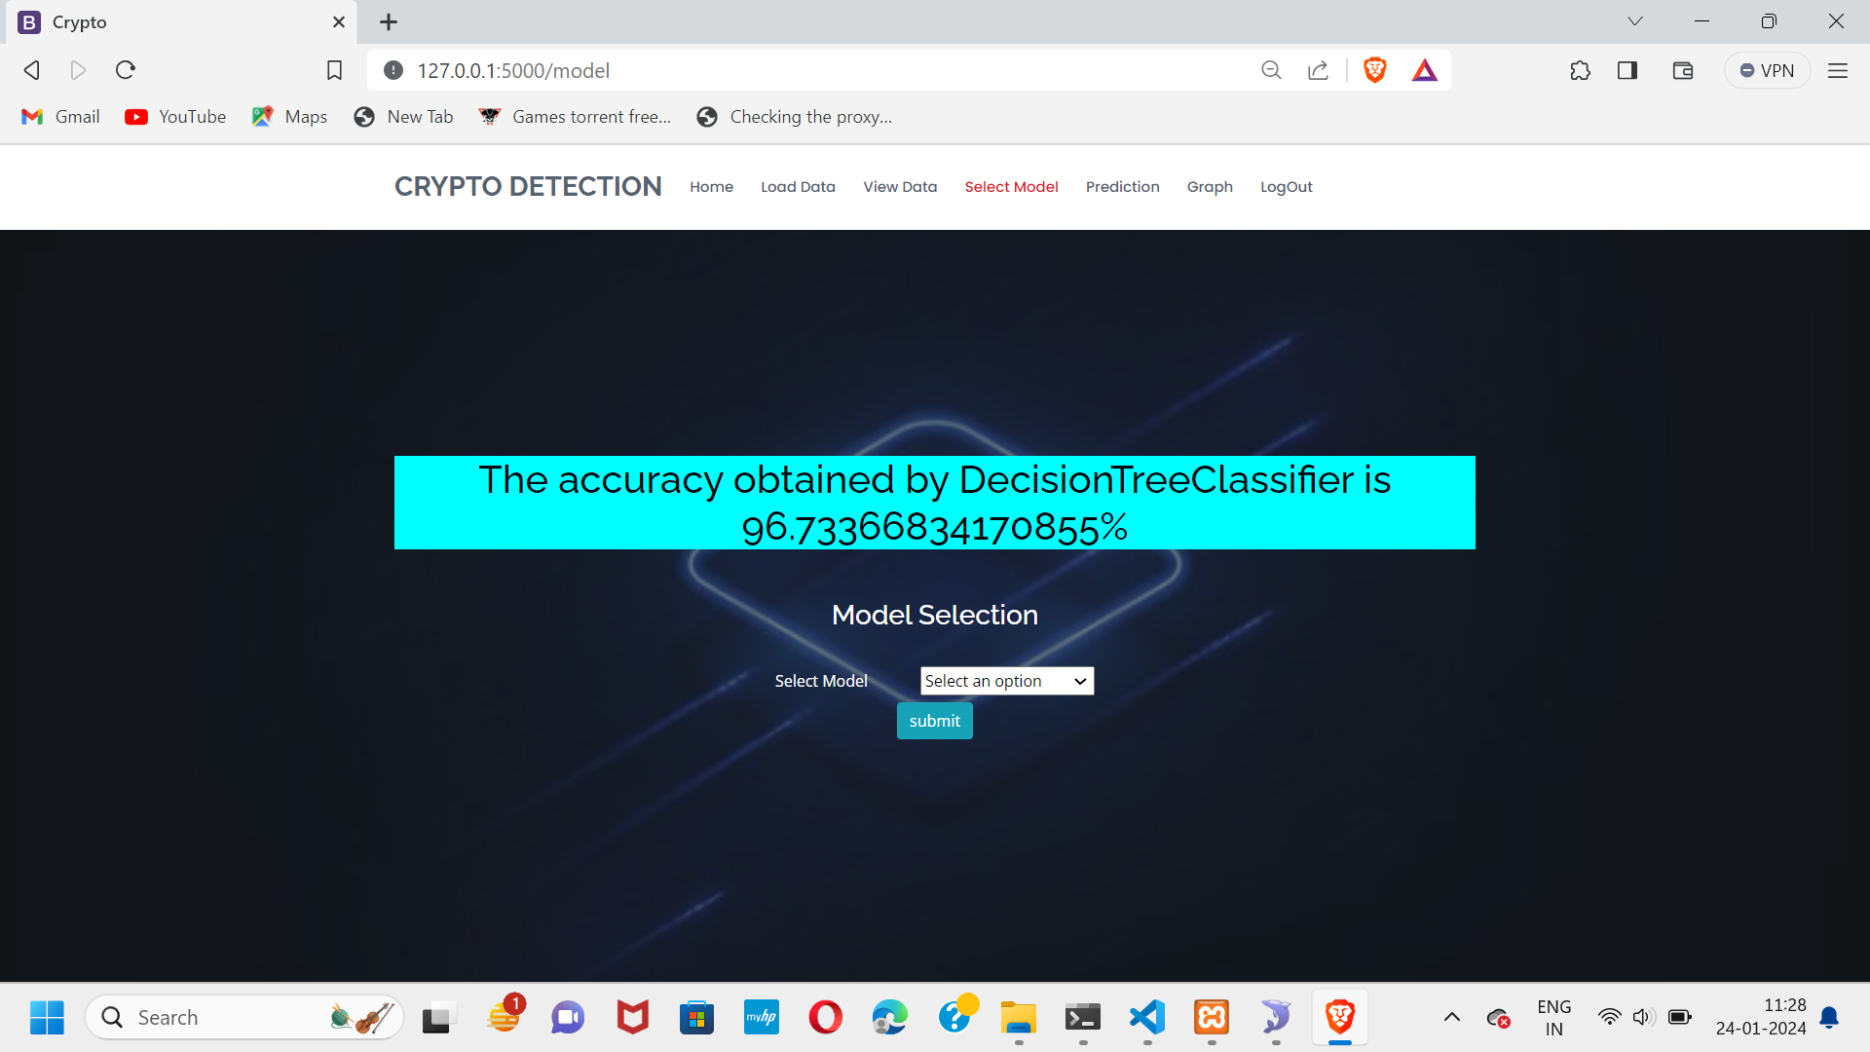
Implementation

Slide 31
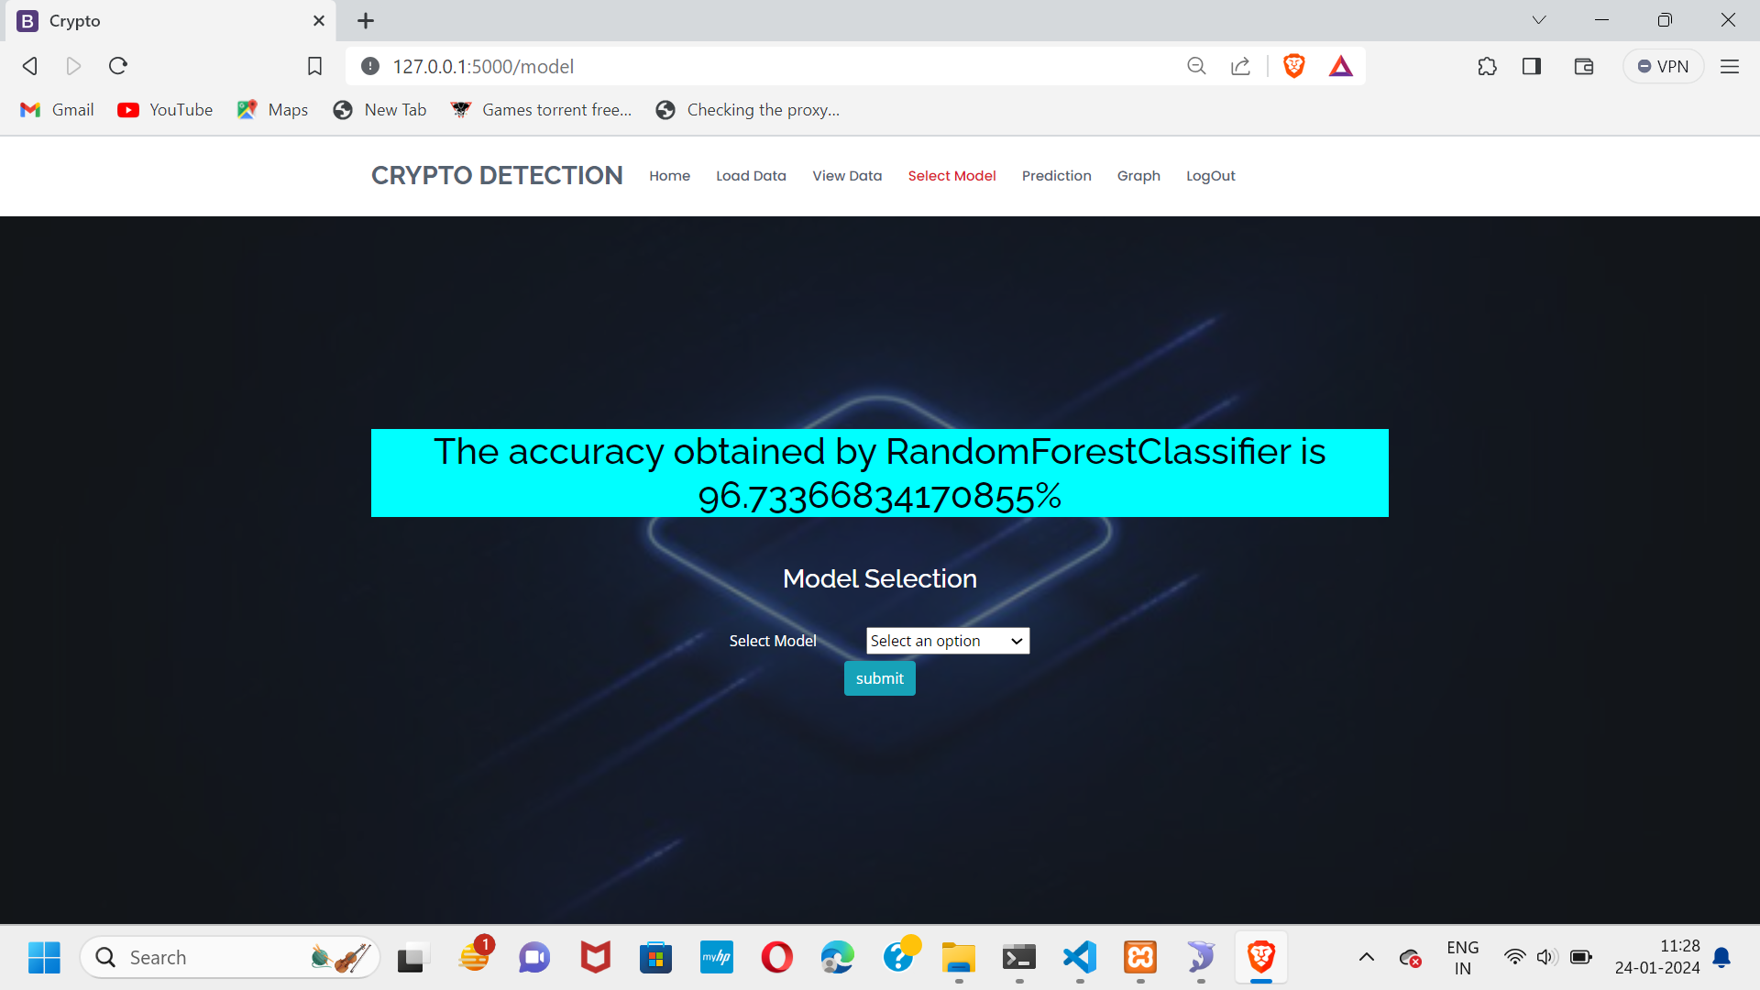

Implementation

Slide 32
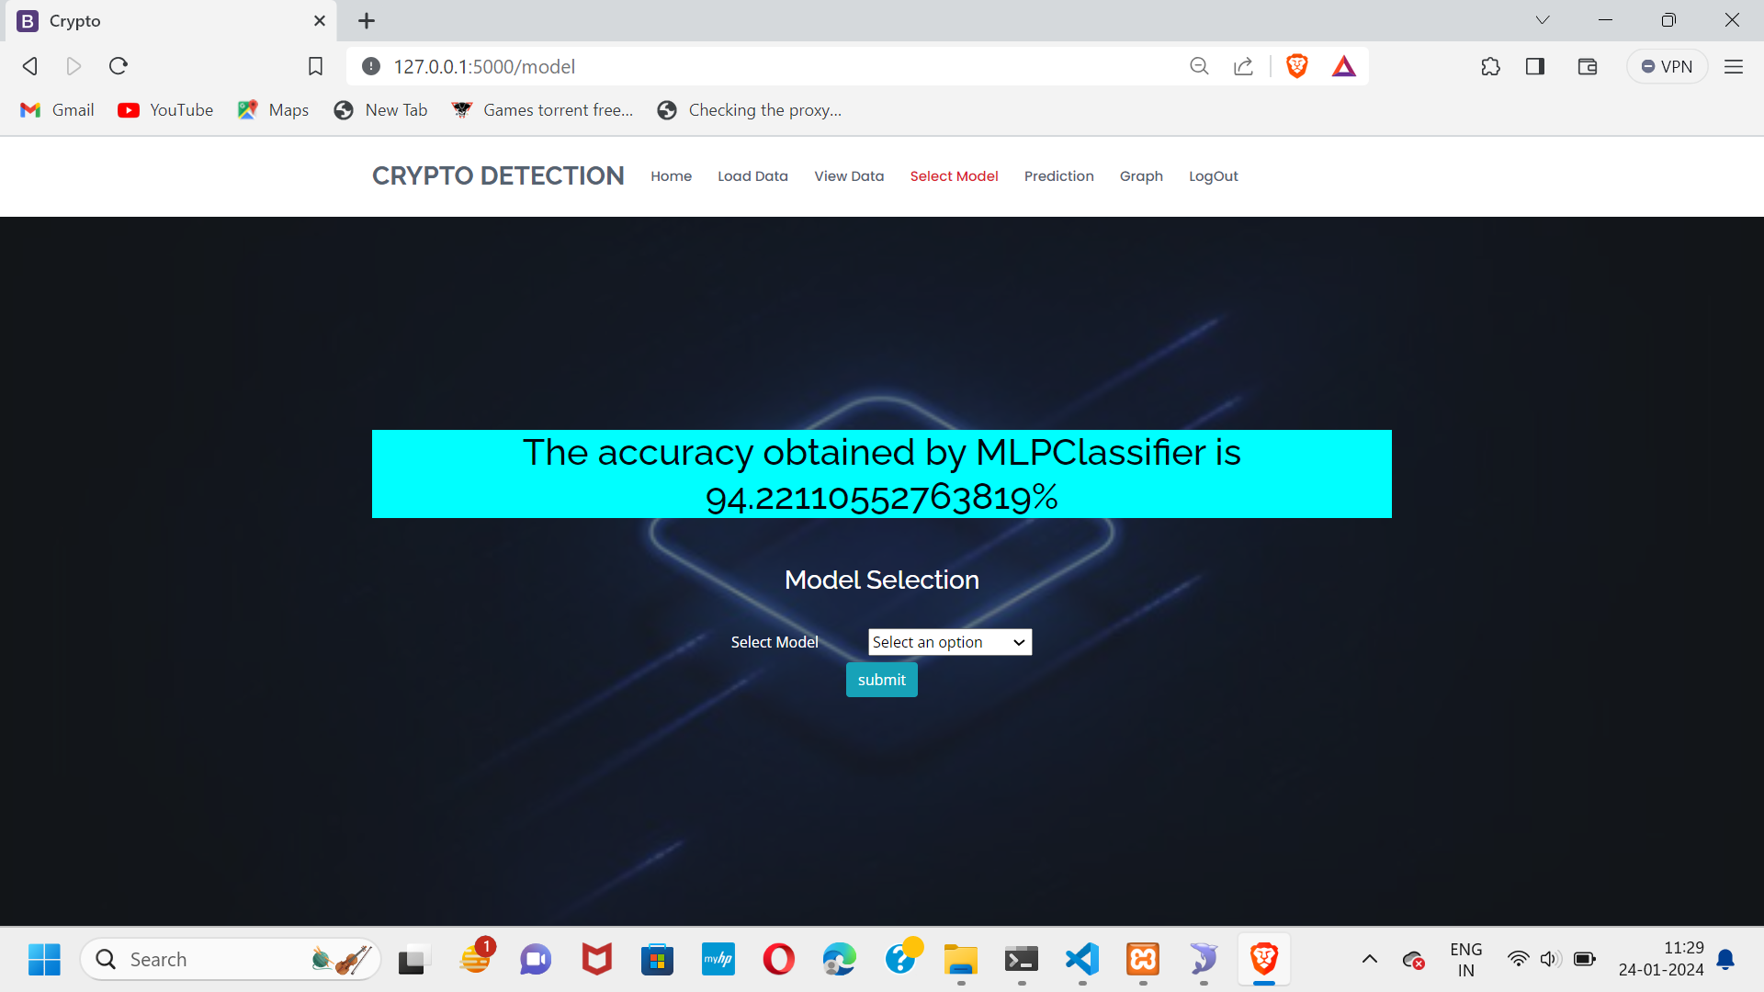

Implementation

Slide 33
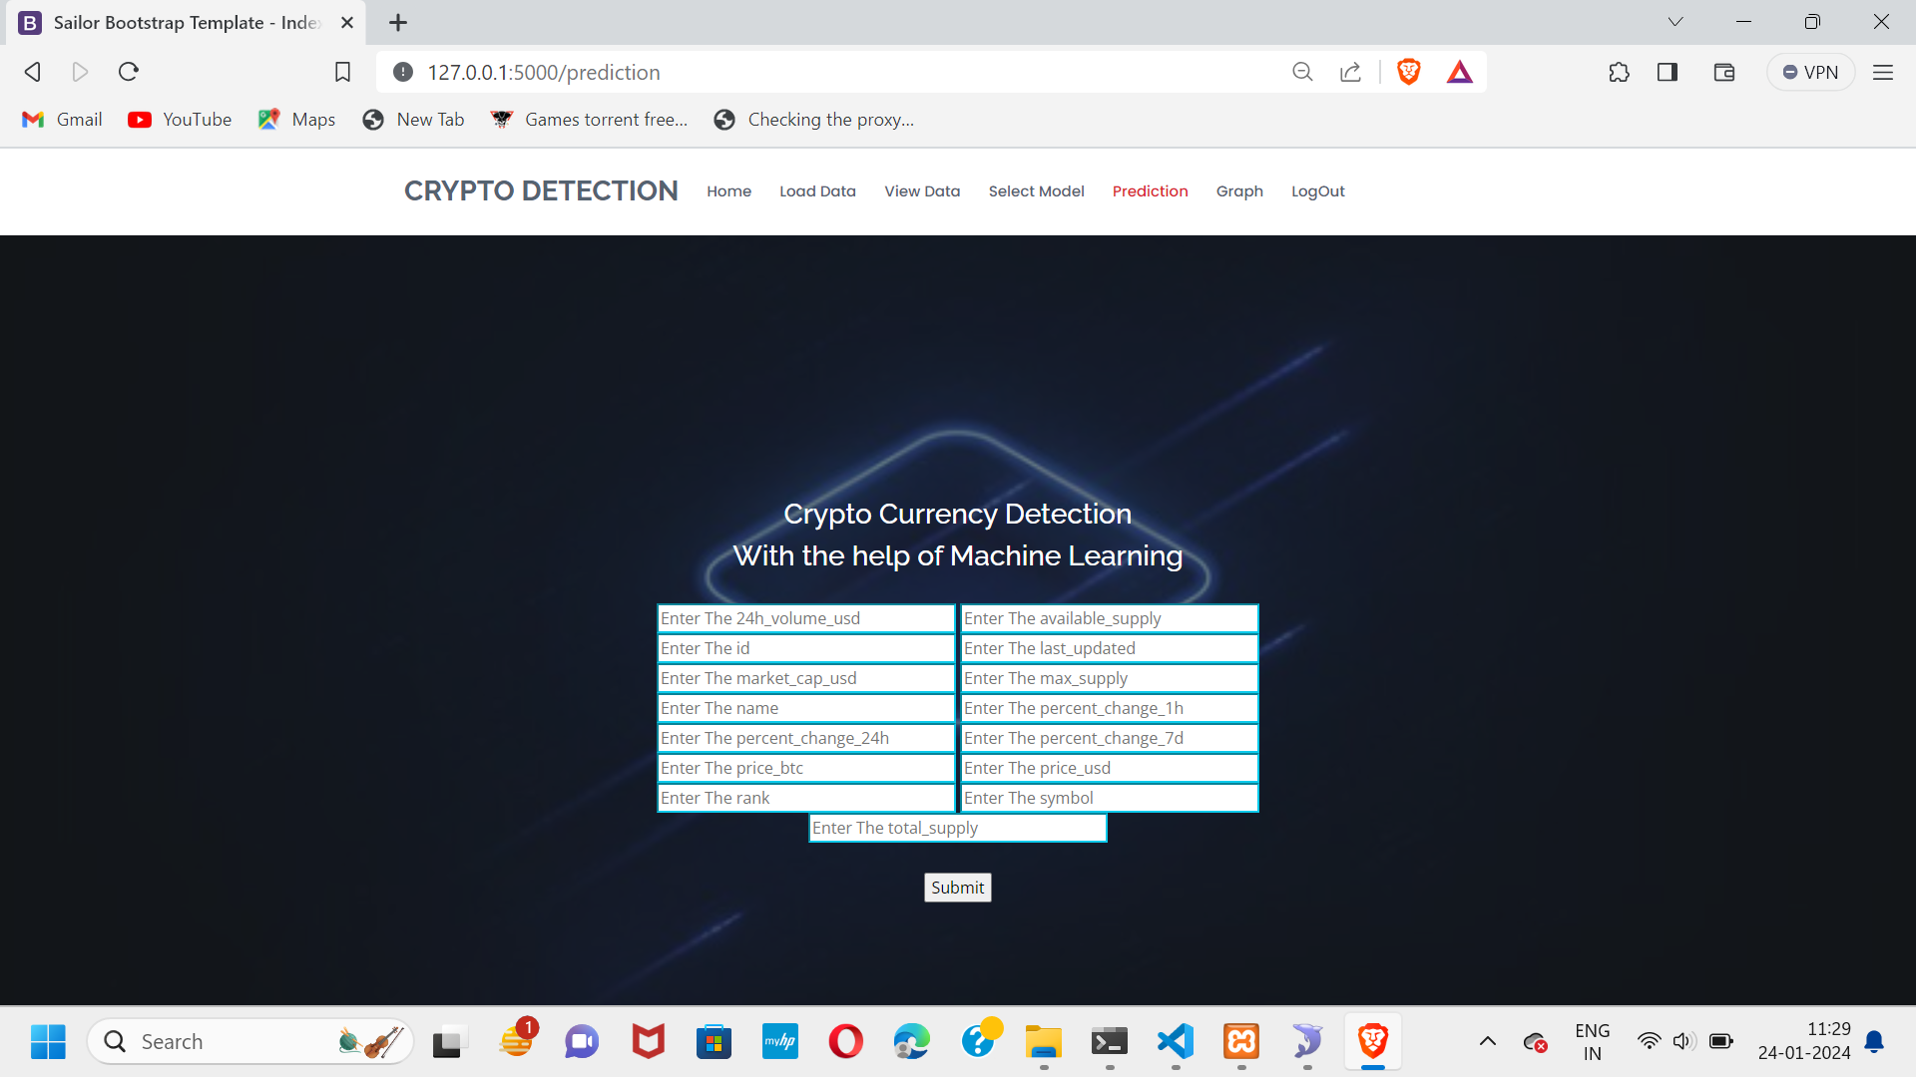
Implementation
In order to find the risk user need to enter below details in prediction section.

Slide 34
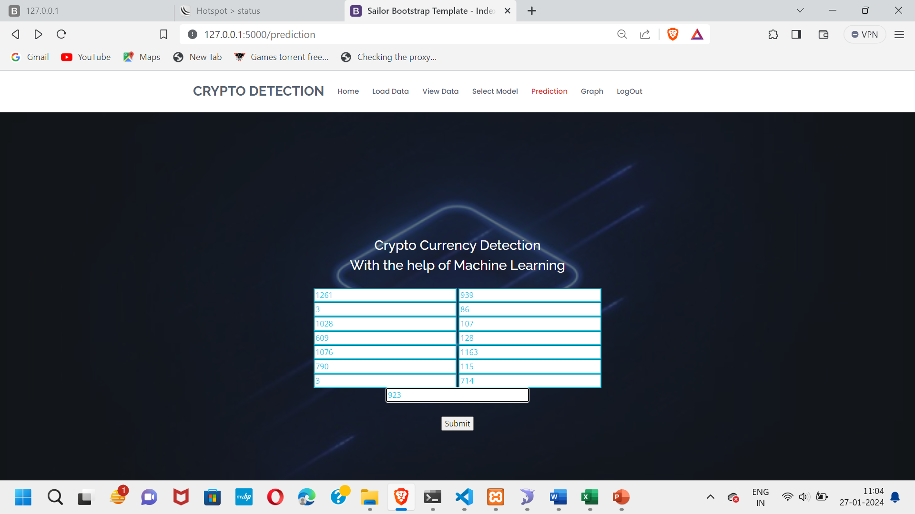
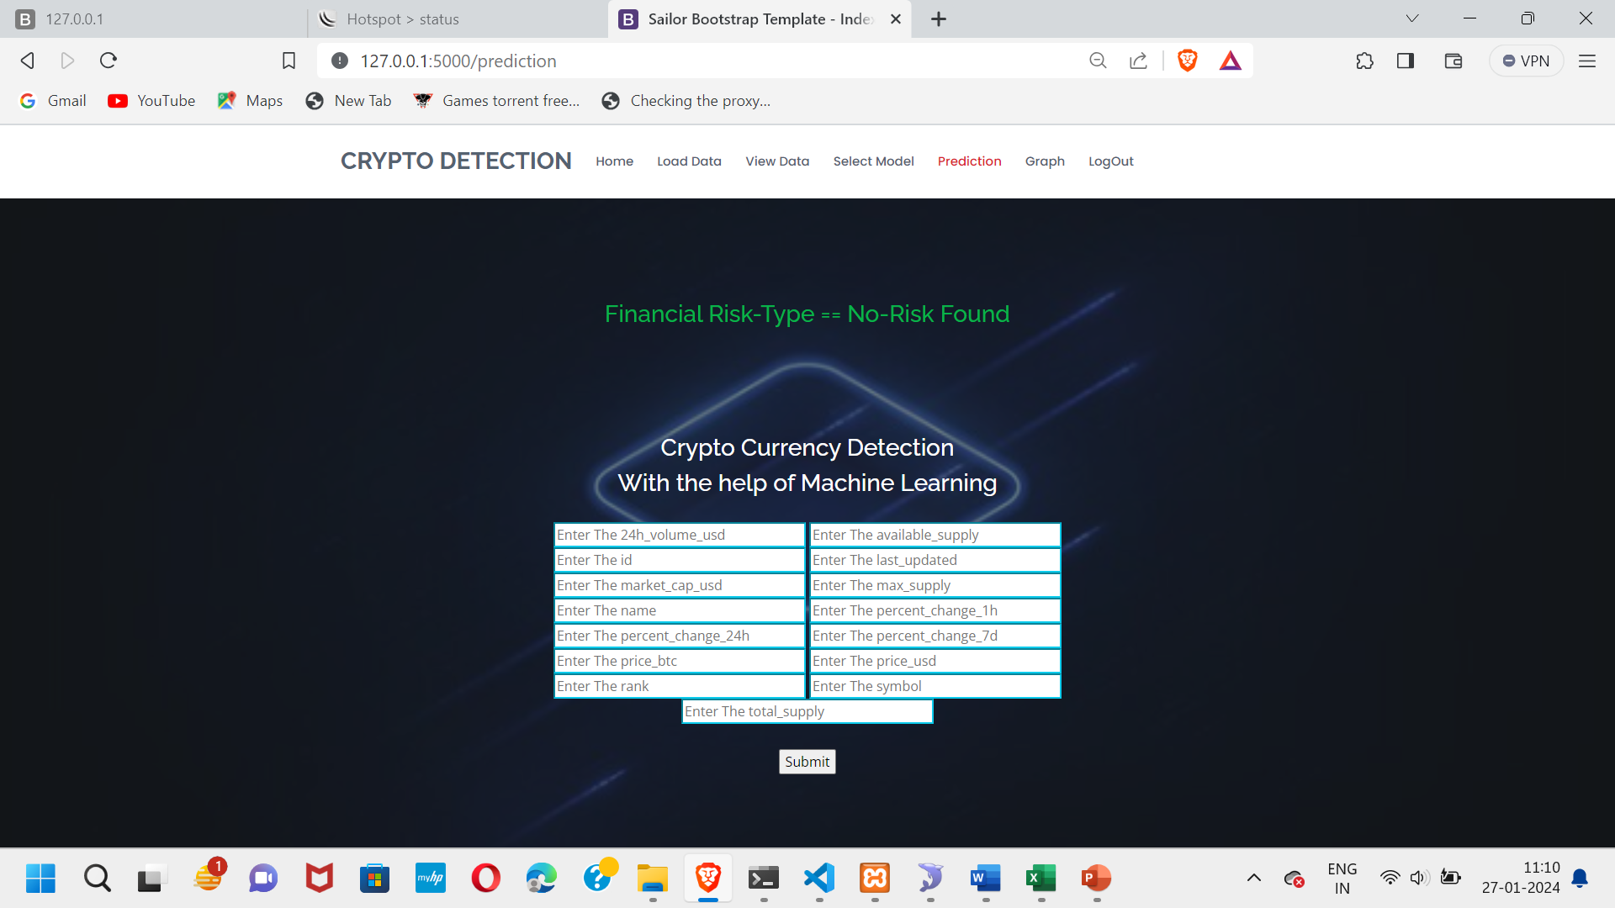
Implementation

Slide 35
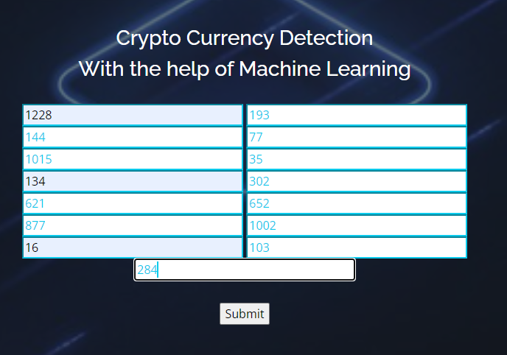

Implementation

Slide 36
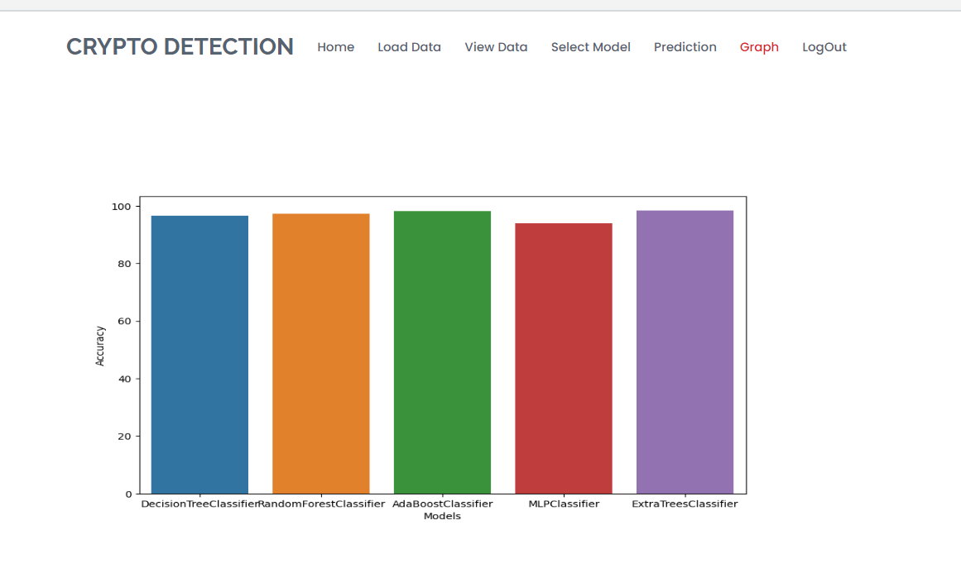
Implementation
In the Graph Section we can see the Comparison among the algorithms used during implementation

Slide 37
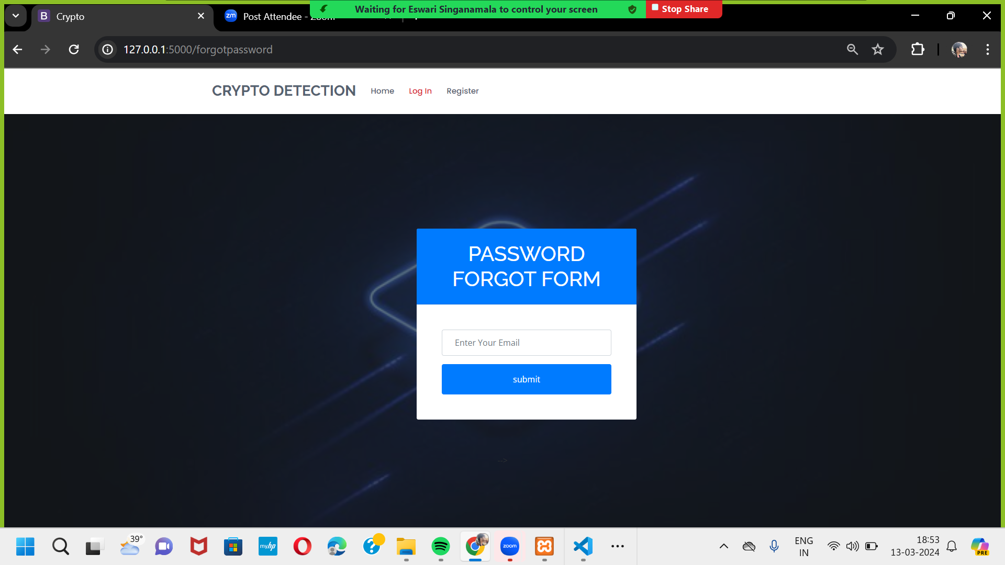
Implementation
If user Forget the password , user can recover it by using forget password option as shown below.

Slide 38
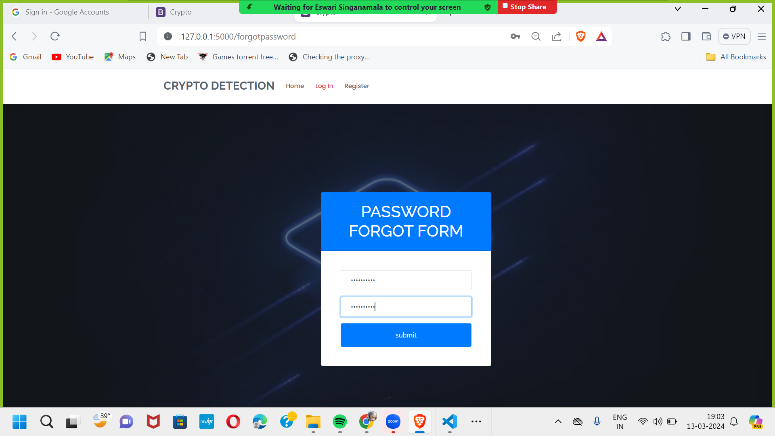

Implementation

Slide 39
Implementation

Slide 40
References
[1]. Zeinab Shahbazi , Yungcheol Byun “Machine Learning-Based Analysis of Cryptocurrency Market Financial Risk Management”.
[2]. Tanya Kapoor , Laxmi Ahuja “Cryptocurrency Financial Risk Analysis using Machine Learning”.
[3]. Dr. B. Subba Reddy , k.Samhitha Rao “Machine Learning Based Analysis of Crypto currency Market Financial Risk Management”.
[4]. C. Y. Kim and K. Lee, ‘‘Risk management to cryptocurrency exchange and investors guidelines to prevent potential threats,’’ in Proc. Int. Conf. Platform Technol. Service (PlatCon), Jan. 2018, pp. 1–6.
[5]. J. Gold and S. D. Palley, ‘‘Protecting cryptocurrency assets,’’ Risk Manage., vol. 68, no. 3, pp. 12–13, 2021.

Slide 41
Research Paper
Research Paper

Slide 42

Acknowledgement

Slide 43
Any Queries?

